Slide 1
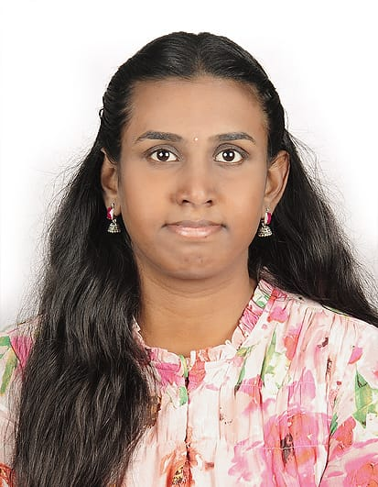
VISHNU PRIYA P
Engineer (Developer)
📍Bangalore, India | 📧vishnupvspriya@gmail.com
Vishnupriya P | LinkedIn |💻 Vishnupriya P | Github | 6360941163|
Experienced engineer (2.8 yrs) in embedded systems, IoT, and GUI development, skilled in C/C++, Python, RTOS, and sensor integration. Currently building ML and Edge AI solutions using TinyML, IoT data, and advanced algorithms for real-time App.
EXPERIENCE
Firmware Engineer – L&T Technology Services (2021–2024), Mysore • nRF SDK, Zephyr RTOS, MSP430 (UART, I2C, LoRa) • GUI: Tkinter, Flask, Node-RED (Thermal Maps) • Projects: CHAMP (Eaton), Thermal Imaging, Transformer Oil Quality using LongRange communication.
Code Review using GitHub Copilot –LTIM (9/25 - 10/25)
EDUCATION
M.Tech – CSE (AI & ML), VIT Vellore | CGPA: 8.56/10
TinyML Anomaly detection (Raspberry Pi, MQ2, DHT11) –Edge Device
Streamlit–Keycloak apps (BERT, LoRA, PySpark, Kafka)
Built a secure OCR app in Streamlit with Keycloak-based RBAC, processed data via PySpark, streamed results through Kafka, and extended the framework for LLM features like sentiment analysis.
B.Tech – ECE, DSU Bangalore | CGPA: 7.99/10
Robotic Arm (ESP8266, Blynk) for swab Sampling.
Eye Cursor Control and Eye Coding (CNN)
Certifications: On Python Beginners, C++, nRF SDK Fundamentals, MSP430 Architecture, Node-RED from IBM.
TECHNICAL SKILLS
Languages:
C, C++, Python, Embedded C
AI / ML:
CNN, RNN, BERT, LoRA, TinyML, LLM, Agentic AI, MLOps, GAN, RAG, Object Detection, Image Processing
Tools & Frameworks:
TensorFlow, PyTorch, PySpark, Flask, Streamlit, Docker, Kafka, Node-RED, Power BI, Angular, VS Code, Code Composer Studio, Google Colab, Azure (Basics), MS Office
Embedded Systems:
nRF SDK, MSP430, Arduino, Raspberry Pi, RTOS, ESP8266; experience with wired sensors and actuators (e.g., temperature sensors, servomotors)
Other Tech Stacks:
Docker, Kafka, Azure (Basics).
LANGUAGES
English: Fluent Kannada: Fluent Tamil: Proficient Telugu: Proficient Hindi: Proficient
INTERESTS
Embedded AI/Tiny ML
AUTOMOTIVE
LLM & NLP
LINUX and edge AI for IoT (R&D)
ACHIEVEMENTS & INTERNSHIPS
• Journal: Eye-based Cursor Control (Wiley, 2023) • SIH 2020 Qualifier – Seizure Alert Device • Internships: LTTS, Bosch Rexroth, BEL

